Slide 1
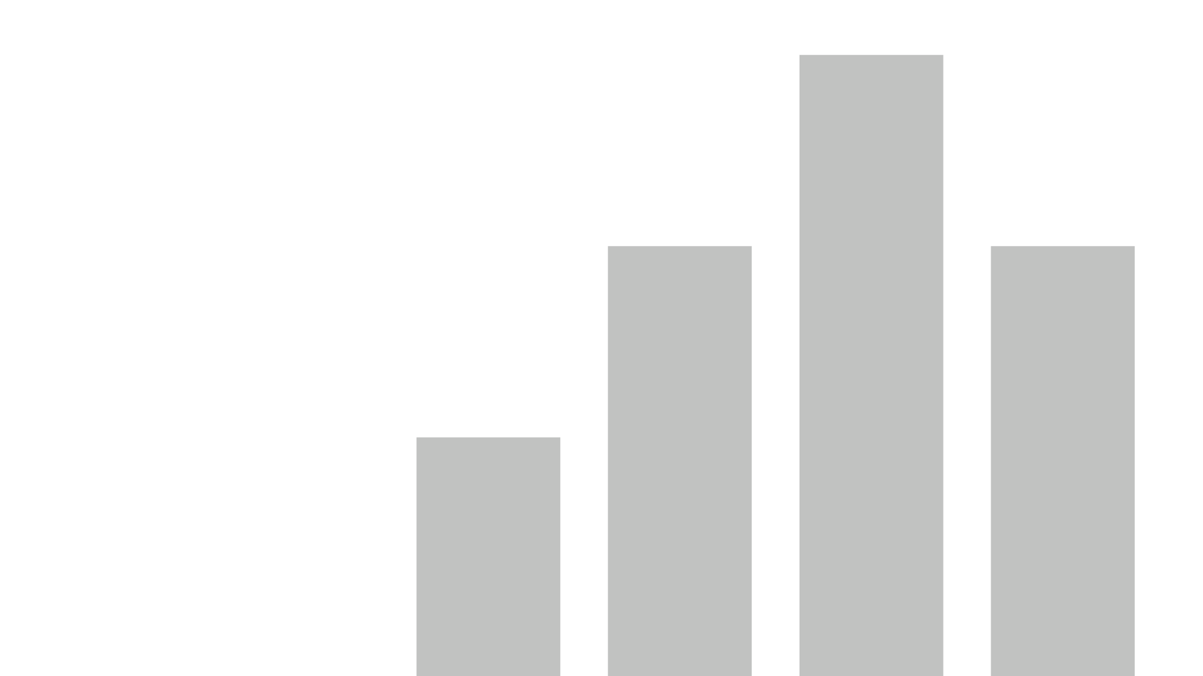


neighboring wells
View in Power BI
Last data refresh:
11/30/2017 11:12:35 AM Central Standard Time
Downloaded at:
11/30/2017 9:51:18 PM Central Standard Time

Slide 2
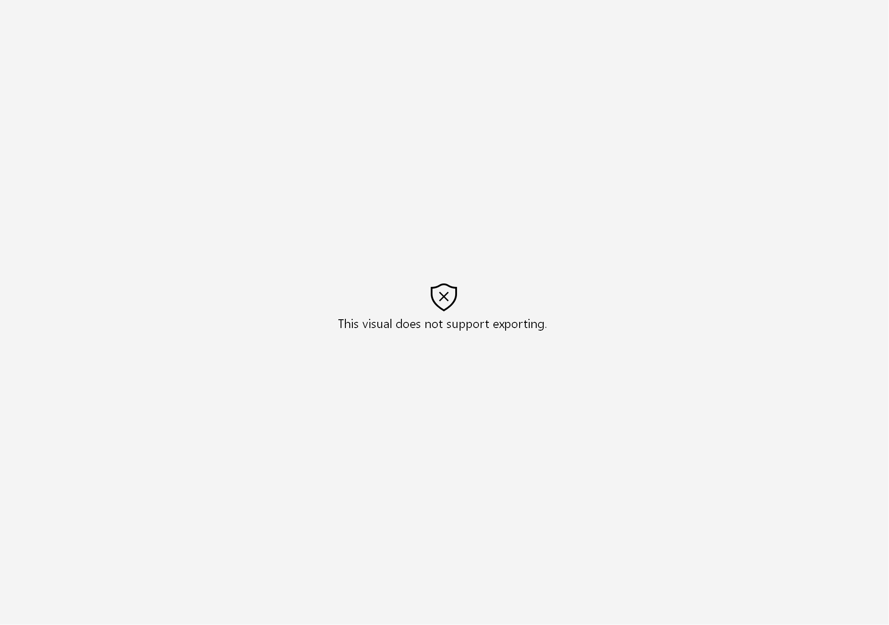

Slide 3
